Slide 1
Metadata & Persistent identifiers
Espen Åberg
Data Steward
ELIXIR Norway/BioMedData
Illustrative Icons from Font Awesome licensed under Creative Commons Attribution 4.0 International License

Slide 2
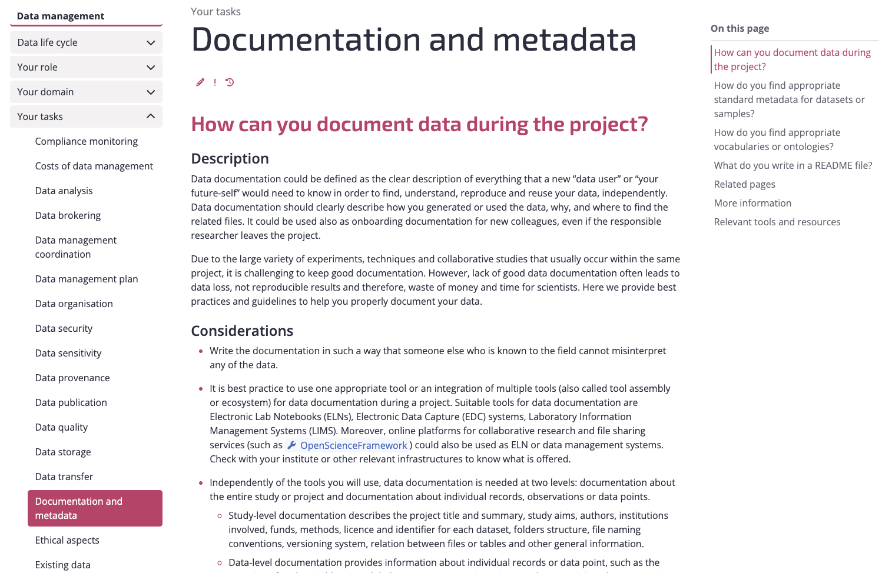
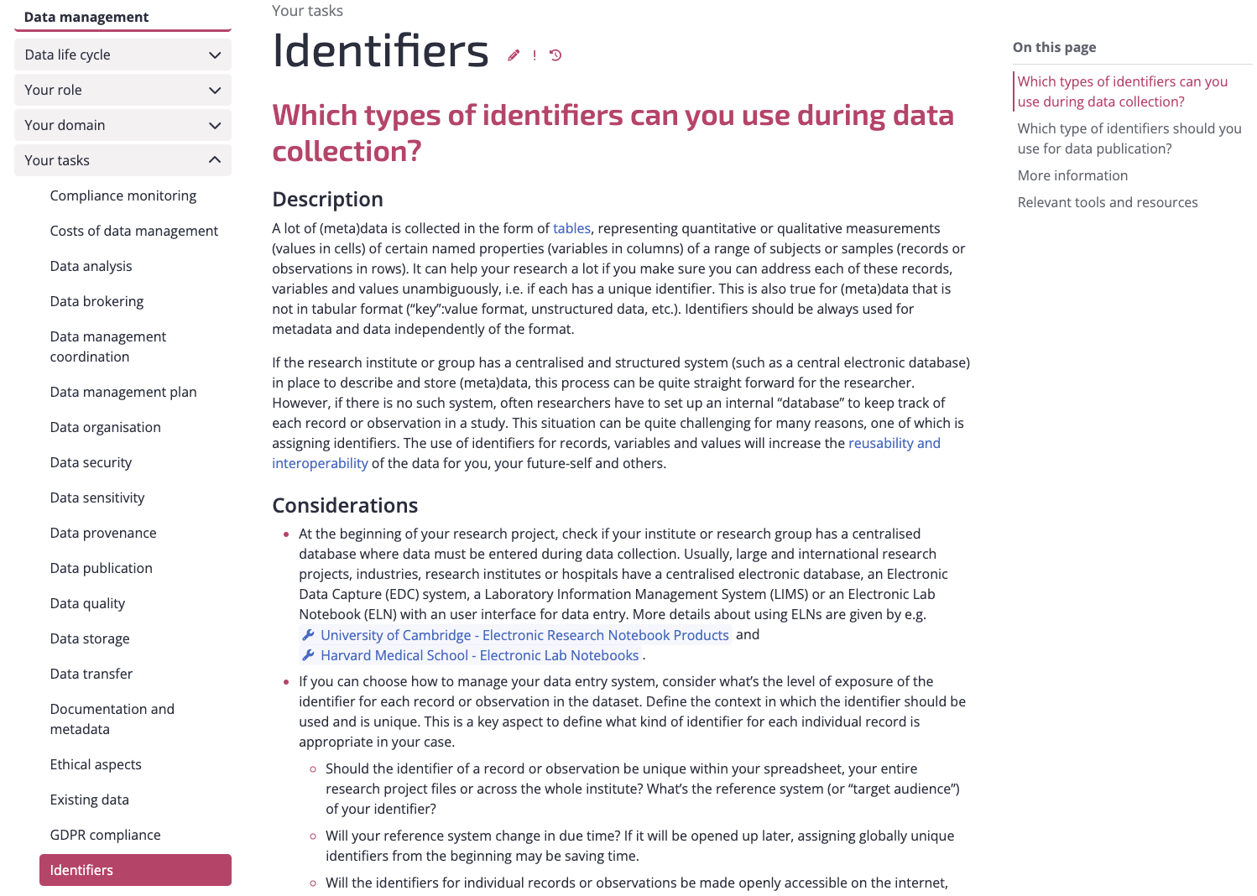
Link to RDMkit: https://rdmkit.elixir-europe.org/

Slide 3
What is metadata?
Has a useful purpose
Can be acted upon and processed by humans and machines
“Metadata is constructed, constructive, and actionable.”
Definition from Karen Coyle, Digital Librarian and Author of Coyle's InFormation
“information about something”
“data about data”
“Data is content, and metadata is context”
"Metadata is a Love Note to the Future"
FAIR illustrations icons from ARDC 2018 licensed under Creative Commons Attribution 4.0 International License

Slide 4

Metadata “all over the place”?
Link to RDMkit: https://rdmkit.elixir-europe.org/

Slide 5
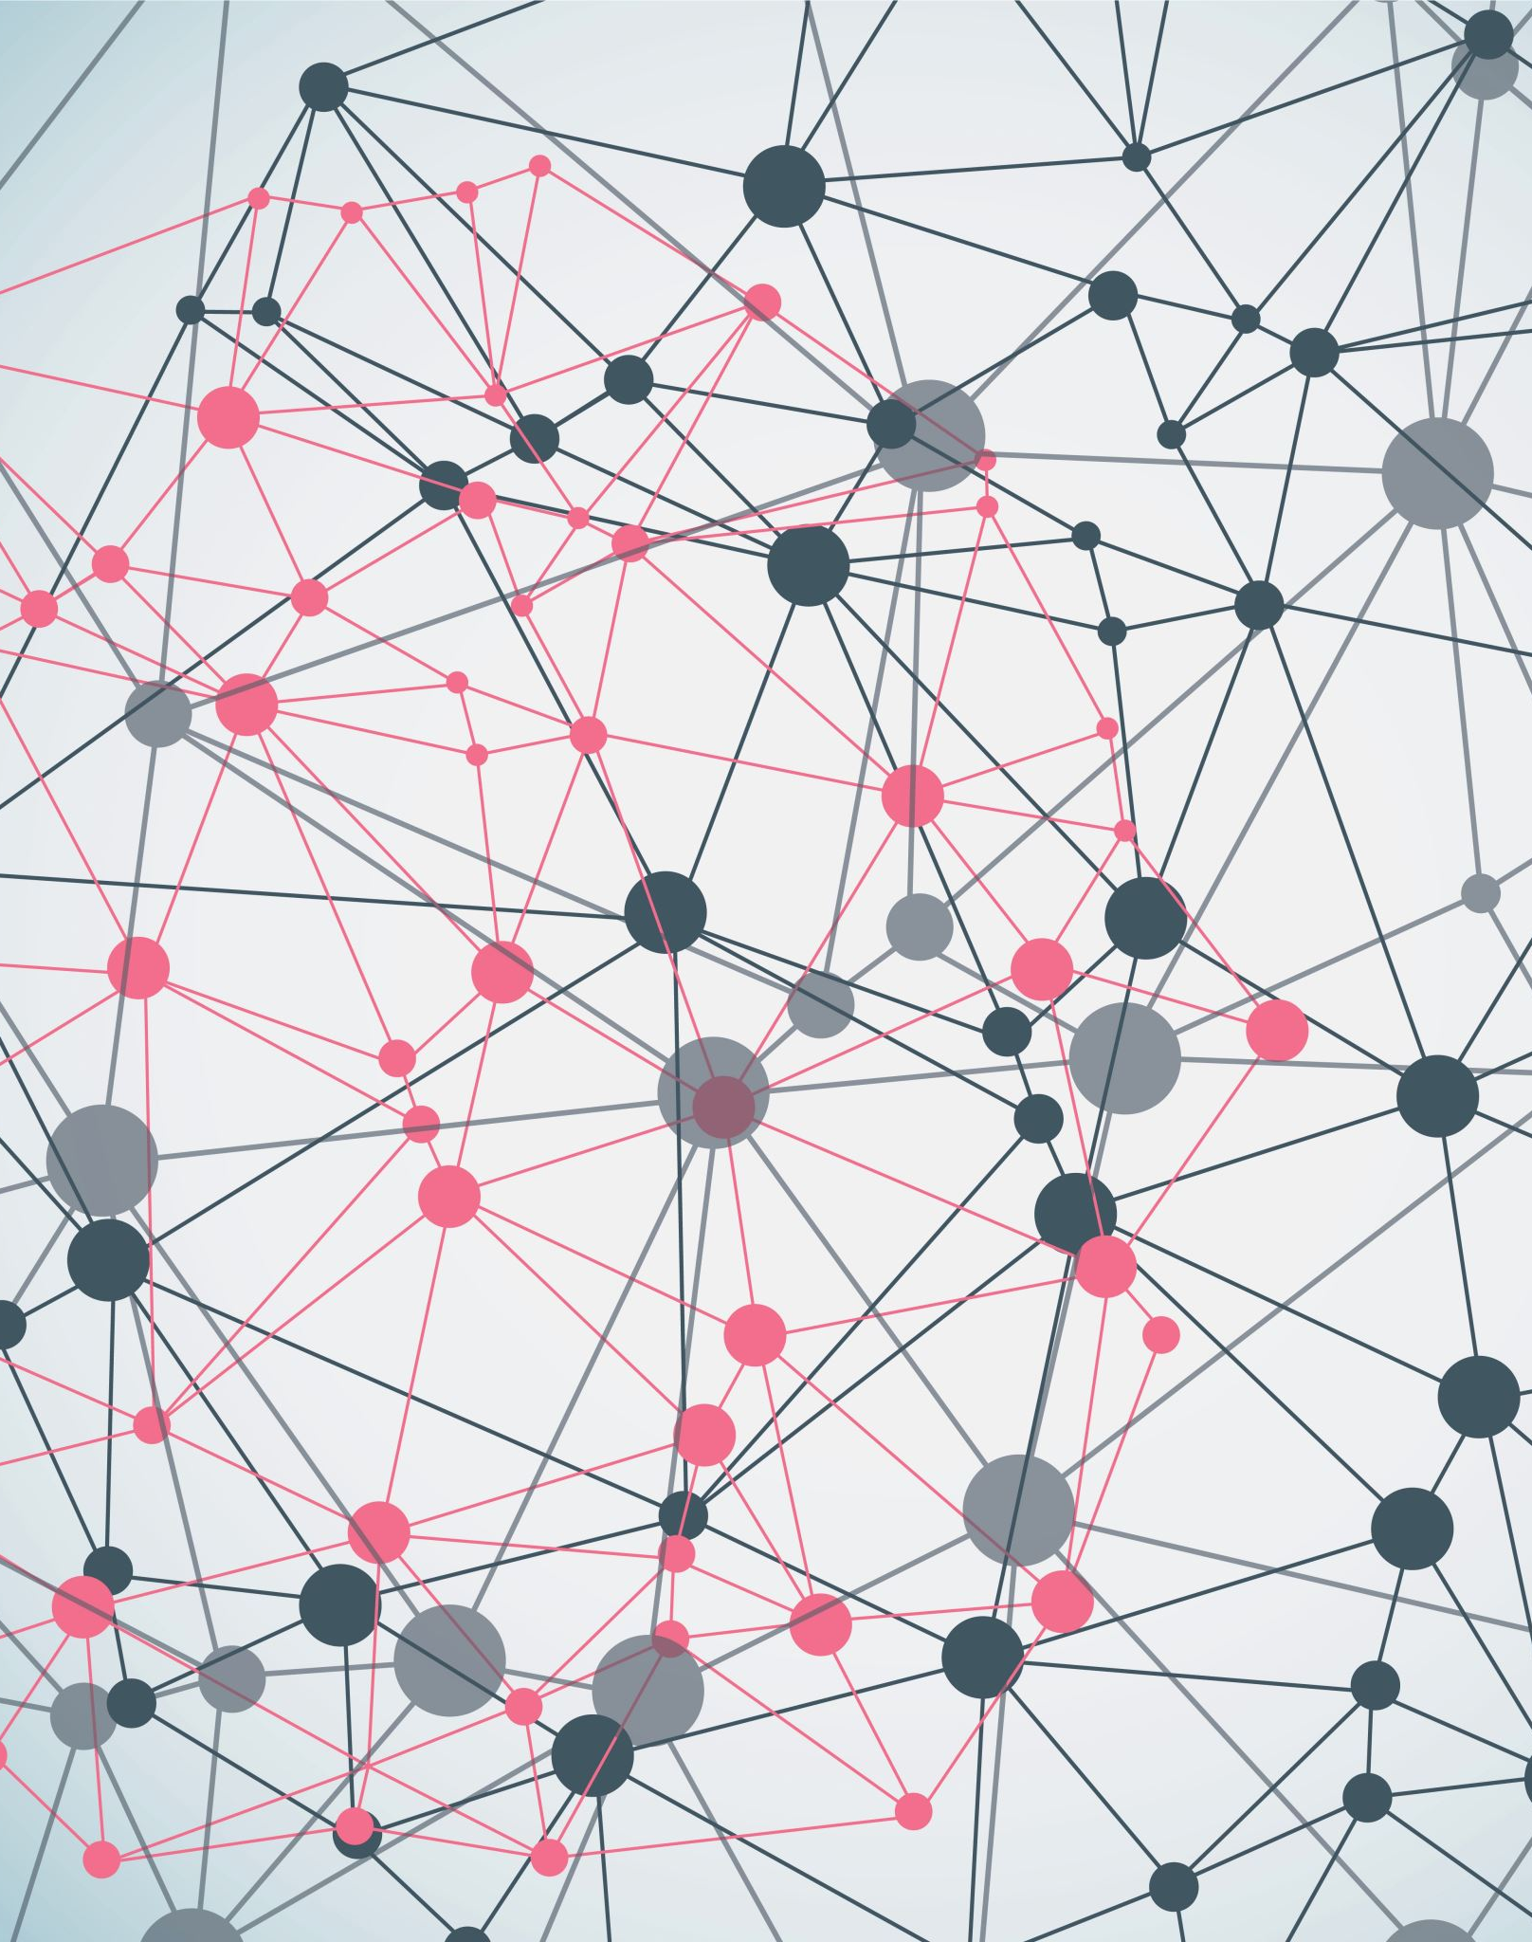
This is why you care
Metadata facilitates organization, indexing, discovery, access, analysis, and use of data.
Metadata presence and quality (or the lack thereof) can significantly help or hinder time and money expenditures in research activities.

Slide 6
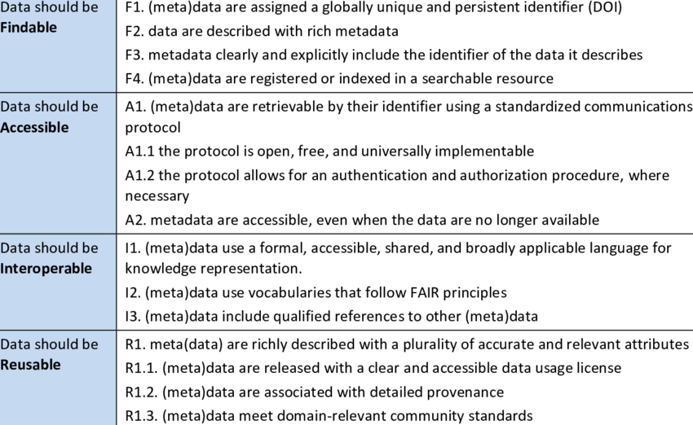
Metadata helps make data FAIR
Medyckyj-Scott, David et al. (2016).

Slide 7
What is Metadata?
“Data”
“Metadata”
Outcome = Treatment effect + Biological effect + Technical effects + Error
Environment
Compound
Infection
Inhibitor
siRNA
sgRNA
Dose
Time
Sex
Age
Weight
Litter
Genotype
Species
Cell line
Operator
Batch
Plate
Cage
Array
Flowcell
Instrument
Day
Order
Source
Experimental
Treatment
Sampling
Measurement
Lazic, S.E. (2016). Cambridge University Press.

Slide 8
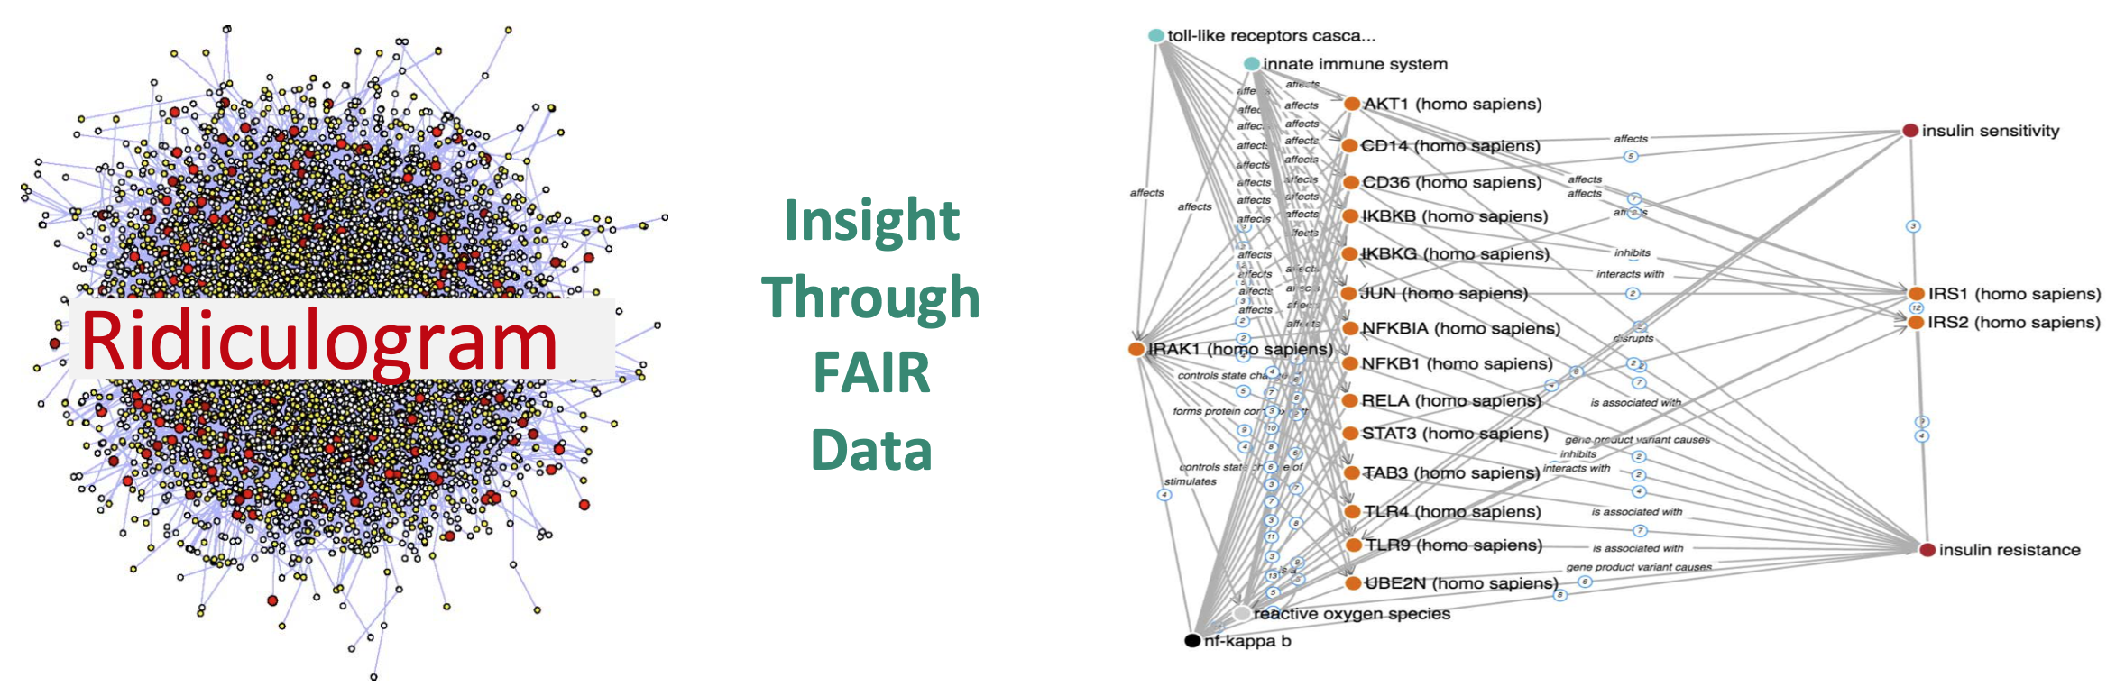



Helps to gain insight
Metadata
“If data is the new oil, metadata is the refinery" — Adam Rauh

Slide 9


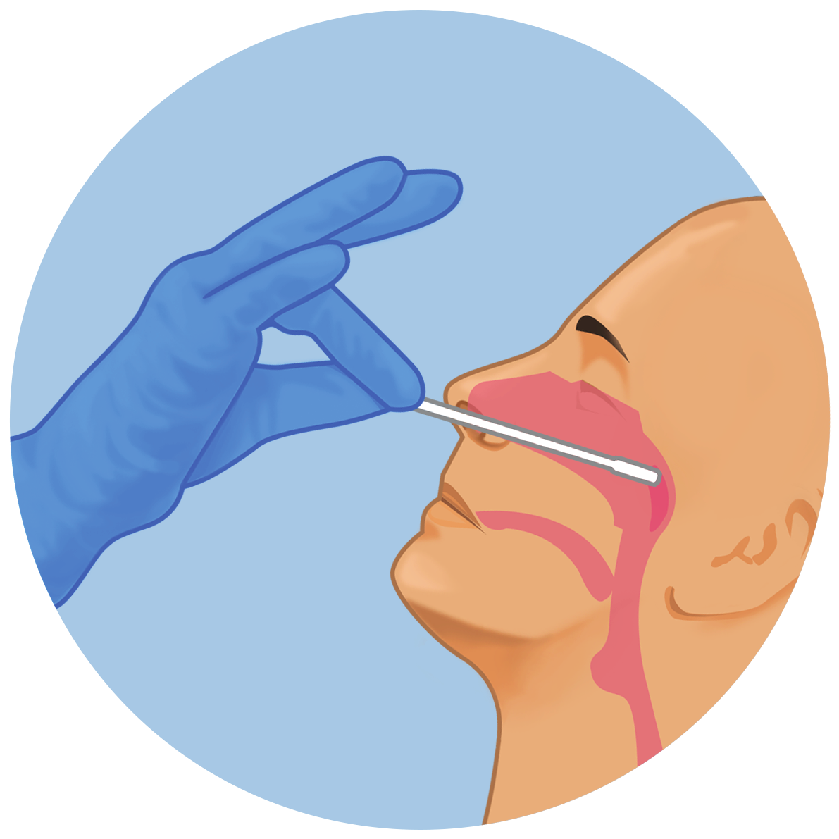
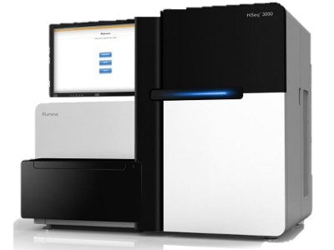


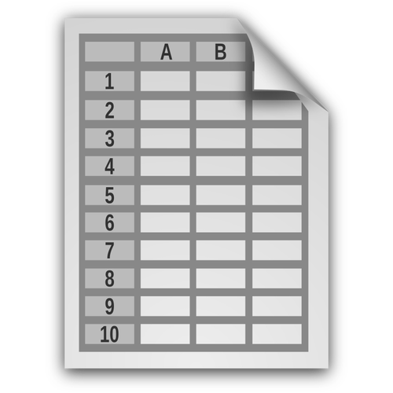
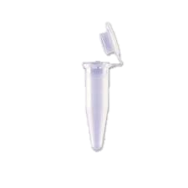






(Meta)data generation and collection
“Protocol” & “project plan” icons by Justin Blake, and “infrastructure” icon by Eko Purnomo, from thenounproject.com
Study & data design
Sampling
& specimen collection
Sample preparation
Sample analysis & data generation
Data processing to prepare inputs for analysis
Data analysis
Communicating results
Procedures
data protection,
ethics permit,
infrastructure,
standards,
protocols,
data dictionaries,
data access, …
Biosamples and instruments
populations (statistical) and inclusion criteria,
physical processing steps,
working storage conditions,
long-term storage location,
sample quality assessment,
sample annotations,
reagents, instruments, kits, …
Data and computational workflows
digital processing steps,
working storage conditions,
long-term storage location,
data quality assessment,
sample/data annotations,
reference data,
analysis method…
Outputs
publications,
data,
tools,
workflows,
reports,
dashboards, …
Slide by: Wolmar N. Åkerström

Slide 10
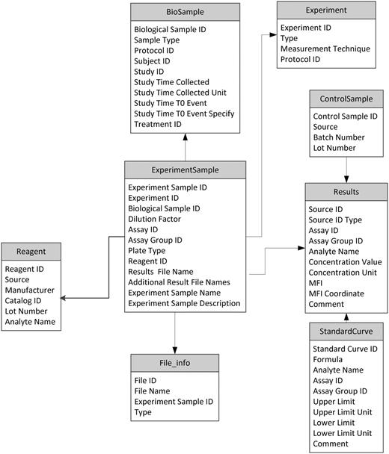
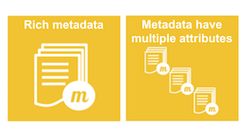
”Rich” Metadata
Authorship:
Creator
Creator date
Modified date
Publisher
Owner
Contact
Descriptive:
Title
Description
Keywords
Theme
Main subject
Version
Review changes
Validation status
Size
Format
Language
Semantic model
Conforms to standard/schema
01000110 01100001
01110011 01110100
01110001 01100110
01101001 01101100
01100101
Digital object (DO)
Metadata
Context:
Project description
Temporal coverage
Spatial coverage
Creation process
Source description
Quality:
Quality parameters
Accessibility conditions:
License
Access rights
Download/access URL

Slide 11


”Rich” Metadata
Authorship:
Creator
Creator date
Modified date
Publisher
Owner
Contact
Descriptive:
Title
Description
Keywords
Theme
Main subject
Version
Review changes
Validation status
Size
Format
Language
Semantic model
Conforms to standard/schema
01000110 01100001
01110011 01110100
01110001 01100110
01101001 01101100
01100101
Digital object (DO)
Metadata
Context:
Project description
Temporal coverage
Spatial coverage
Creation process
Source description
A rule of thumb, you should never say ‘this metadata isn’t useful’; be generous and provide it anyway!»
Quality:
Quality parameters
Accessibility conditions:
License
Access rights
Download/access URL

Slide 12
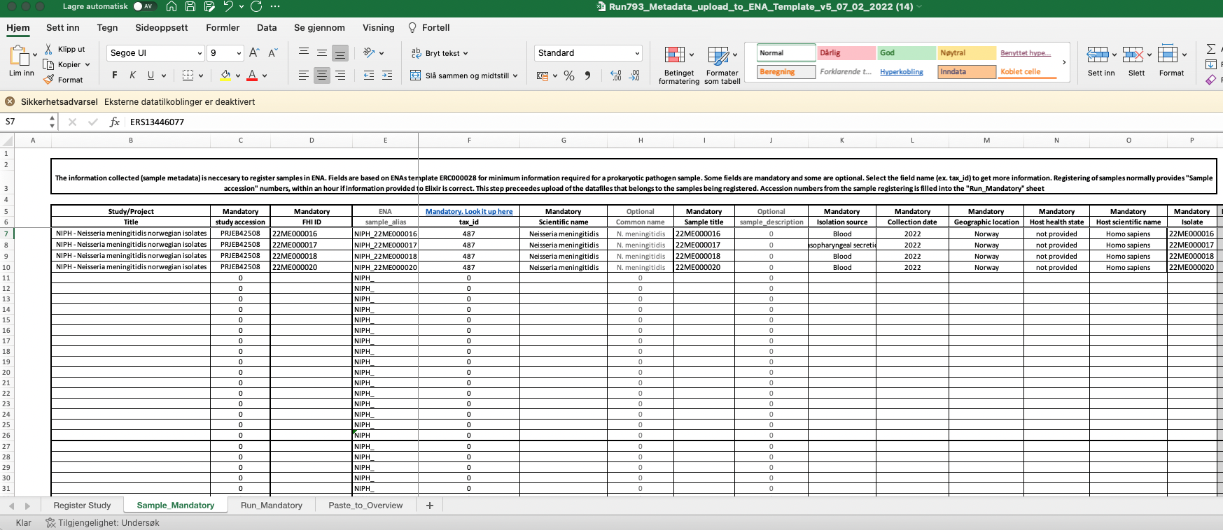

Metadata collection (Simple solution)
Not optimal but can be fitted to a set of rules (schema) and allowed values (controlled vocabulary)
https://rightfield.org.uk

Slide 13
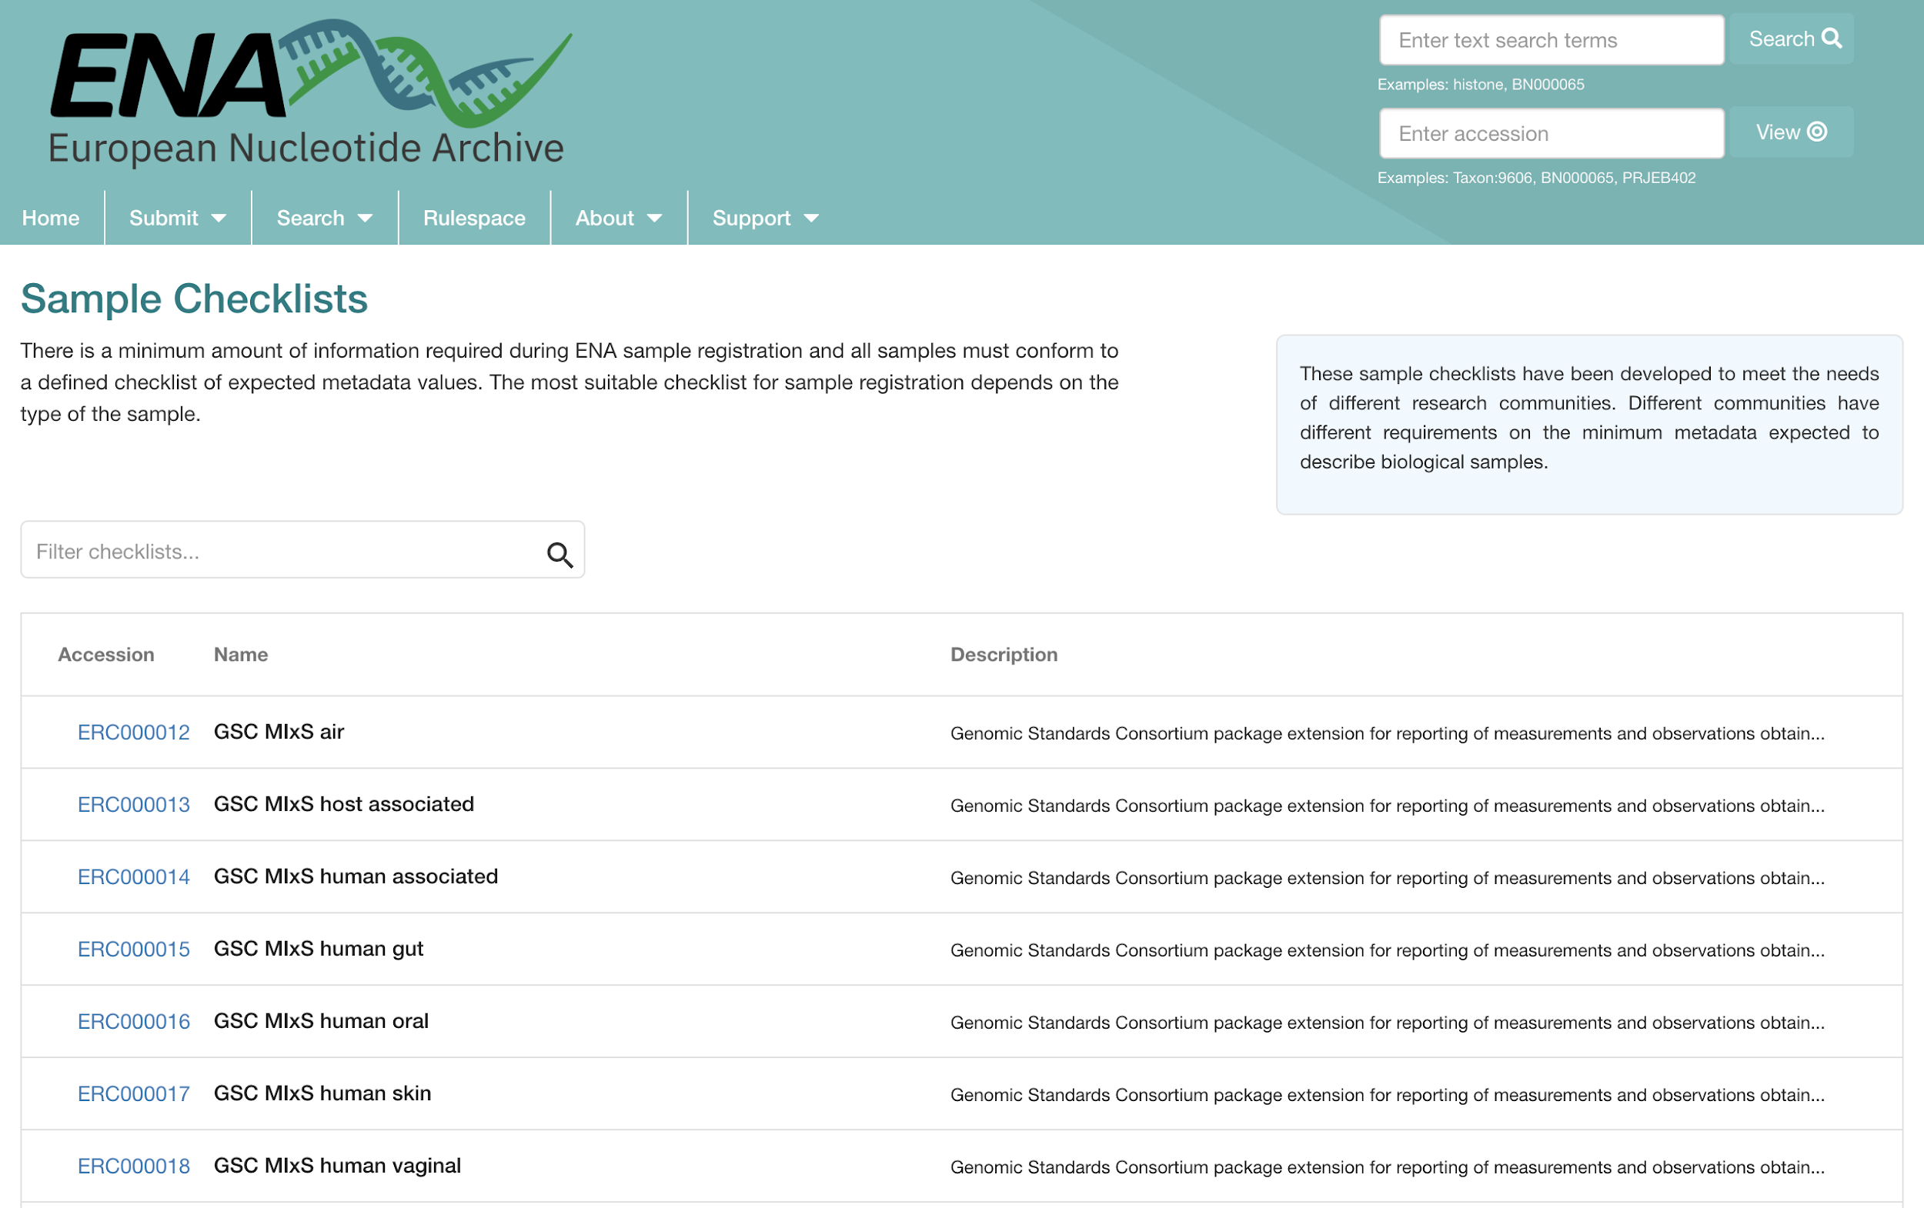
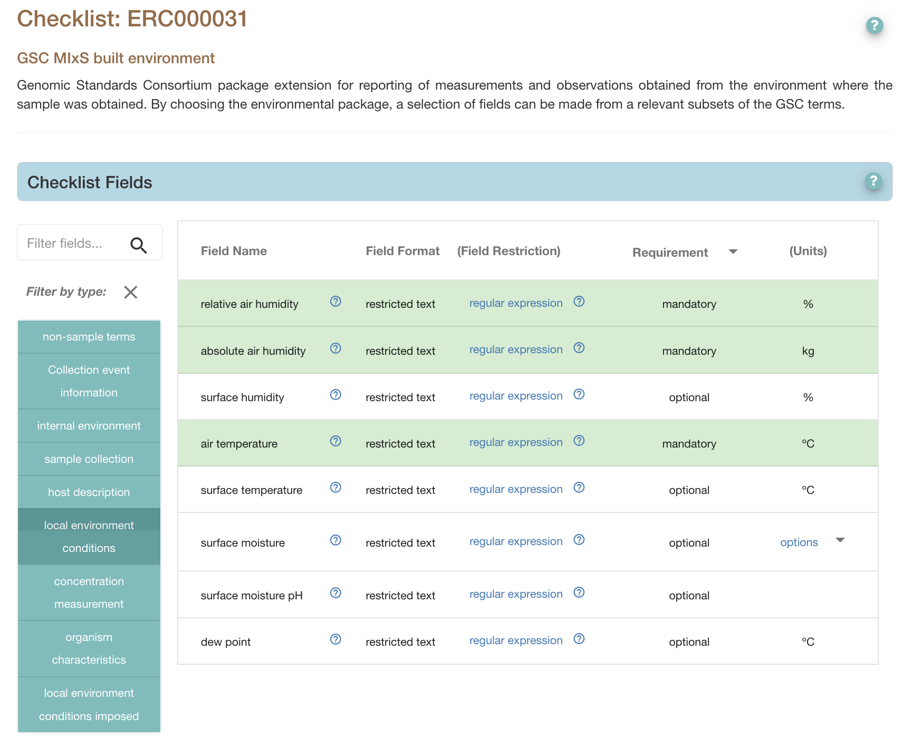
Metadata templates/checklists
https://www.ebi.ac.uk/ena/browser/checklists

Slide 14
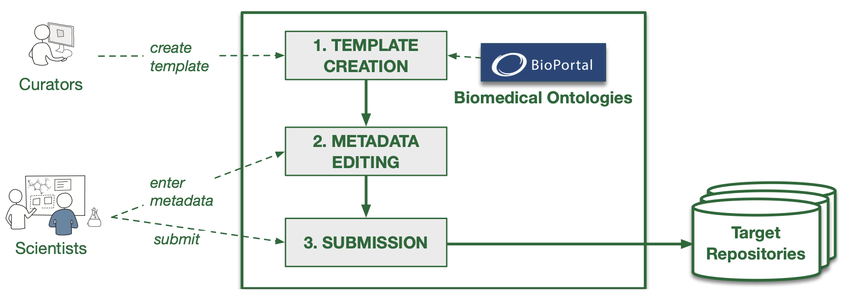
Metadata Submission Workflow
Contribute
Search and reuse
Figure 2 from: Using Semantic Technologies to Enhance Metadata Submissions to Public Repositories in Biomedicine

Slide 15
Different Persona
Project progress
requirements
Receives report
Storage requests
Reports dataset
Defines roles
Deposits data
Create
Assists/
performs
Uploads data
Support
Support
Support
Support
Support
Support
illustration: Korbinian Bösl

Slide 16
Infrastructure tools
Project progress
Requirements
Storage
request
Guidance
Final report
Storage quota
History
History
Sharing
Cold storage
Data for deposition
Tracking of Metadata
Metadata for deposition
Tracking
Tracking
Metadata Trackers
Deposition
Reuse
Preservation
illustration: Korbinian Bösl

Slide 17




Metadata tracking platforms
Domain specific:
COPO for plant sciences
MOLGENIS for biobanking
...
Adaptable (configuration requires domain knowledge):
Proprietary ELNs/LIMS - often poor support for ontologies
openBIS - open source ELN/LIMS
SEEK
https://copo-project.org/ https://www.molgenis.org/
https://openbis.ch/ https://seek4science.org/

Slide 18

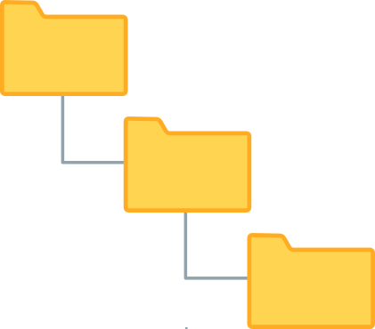

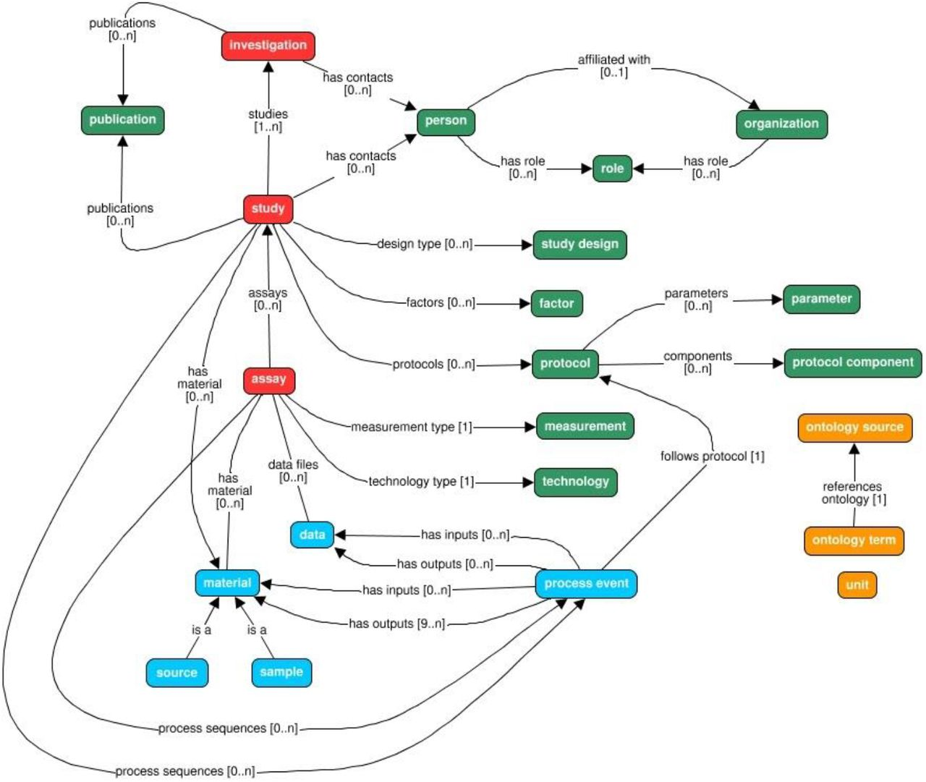

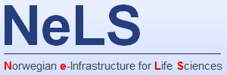
FAIRDOM SEEK
ISA model
Investigation
“overall goals and means”
The SEEK platform is a web-based tool for organising and storing data, for sharing, exploring and annotating data
Study
Subject/Specimen being studied
Assay
Experimental steps and outputs
Integrated
Datasets
eg. FASTQ files
Metadata
(and datasets)
ISA illustration: Rafael Andrade Buono
https://doi.org/10.1093/gigascience/giab060

Slide 19
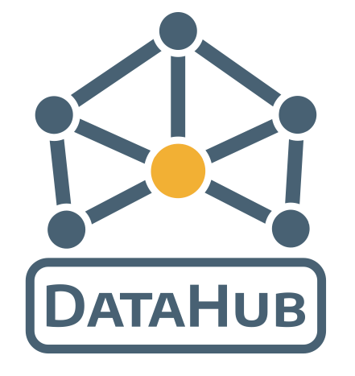
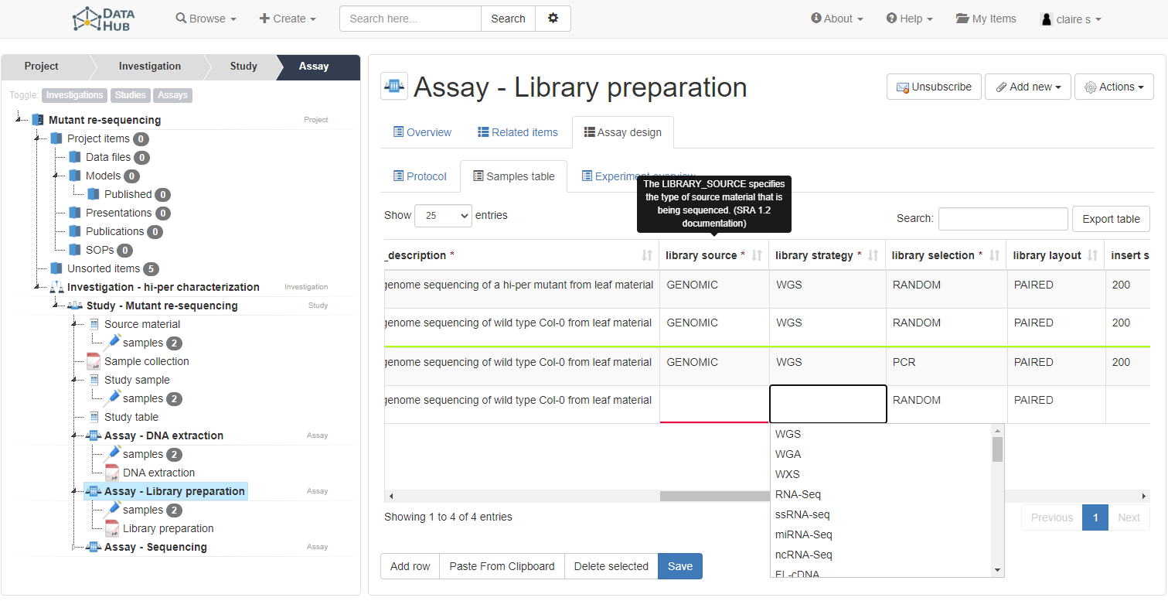
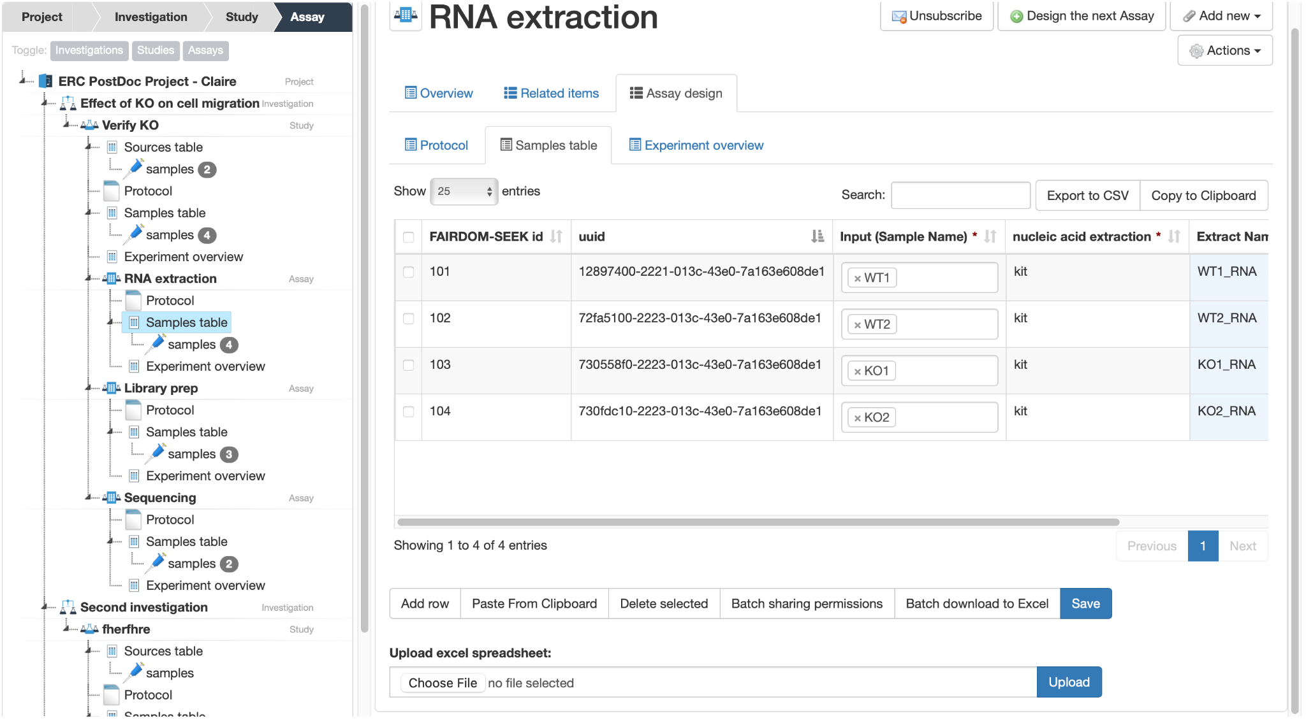
FAIRDOM SEEK in DataHub
Dynamic table for samples metadata
Batch sharing permissions for samples from the dynamic table
https://datahub.elixir-belgium.org

Slide 20
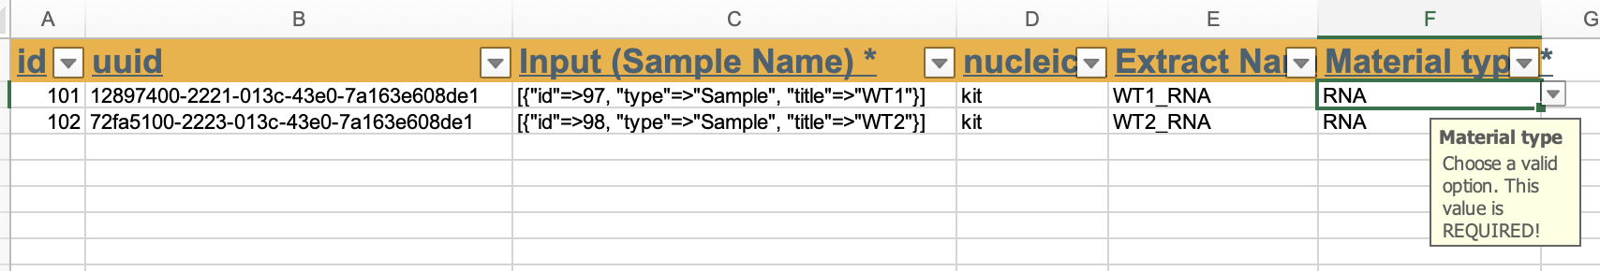
FAIRDOM SEEK in DataHub
Download to Excel
✓
✓
Locked cells

Slide 21

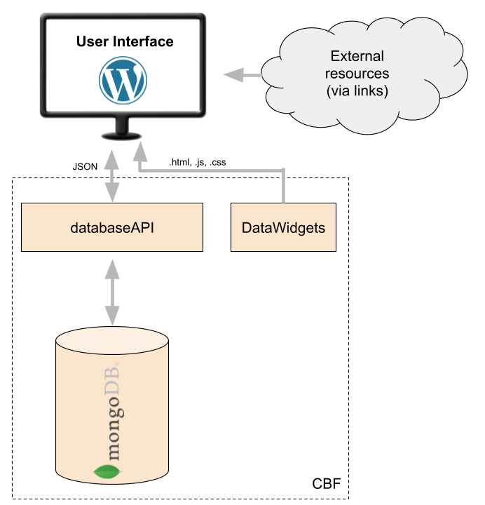








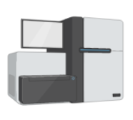
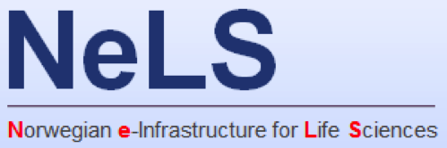

CBF
Data interaction and curation
Rest API
Sp
Is
Sp
Se
As
EBP-Nor
Brokering
EBP-Nor use case - Brokering
Biodiversity datasets
Slide: Terje Klemetsen

Slide 22


Contextual Biodata Framework (CBF)
csv,
tsv
Collect metadata
Share
Visualize & explore
- API
- Download
CBF
- Plots & timelines
- Cart & geo location
- Rich filtering
FAIR
Communicate
- Versioning
- Linked data
- Annotations
- Wordpress plugin
(easy web integration)
Slide: Terje Klemetsen

Slide 23
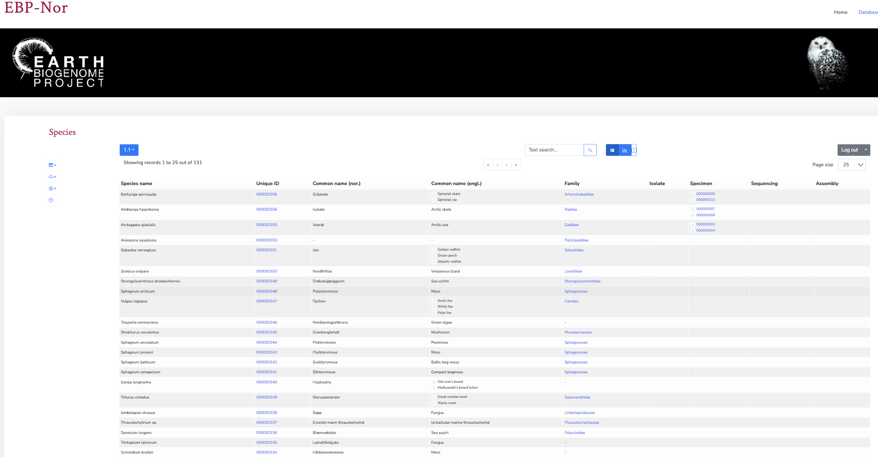
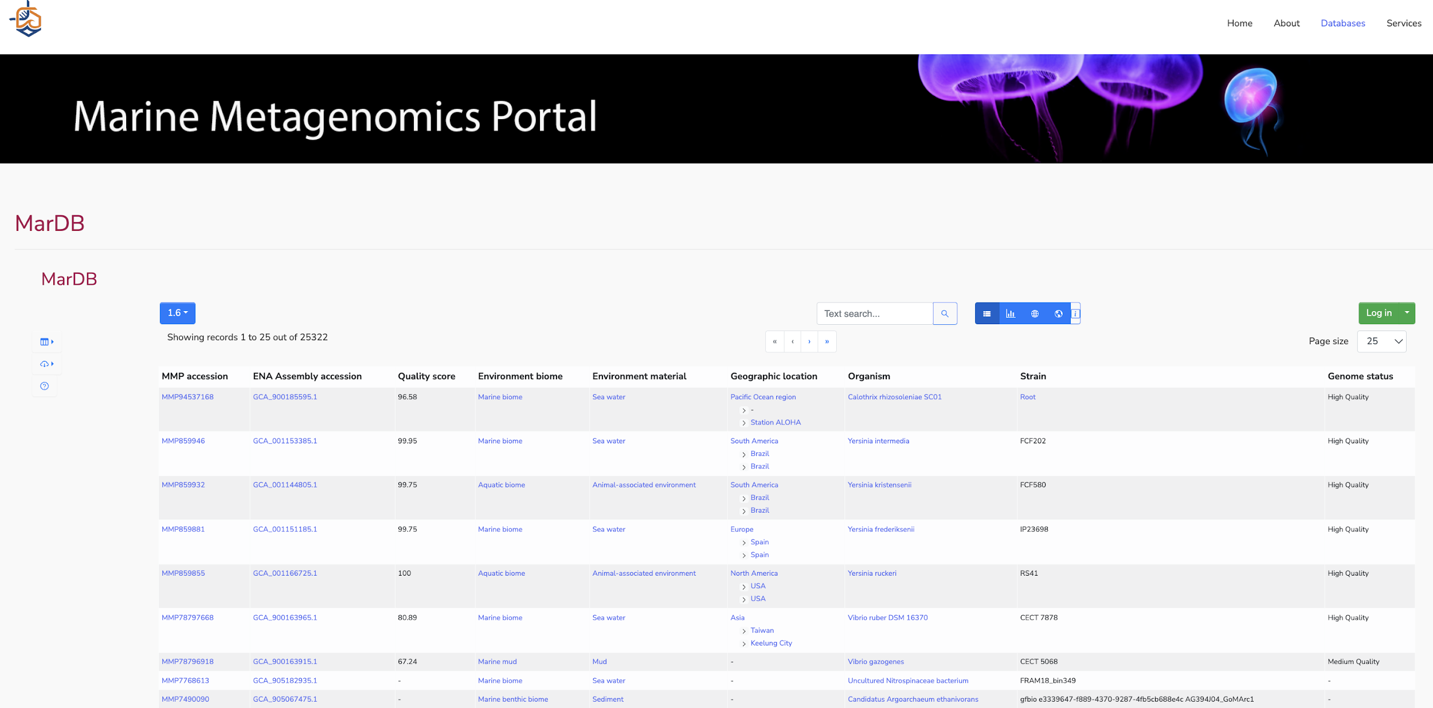
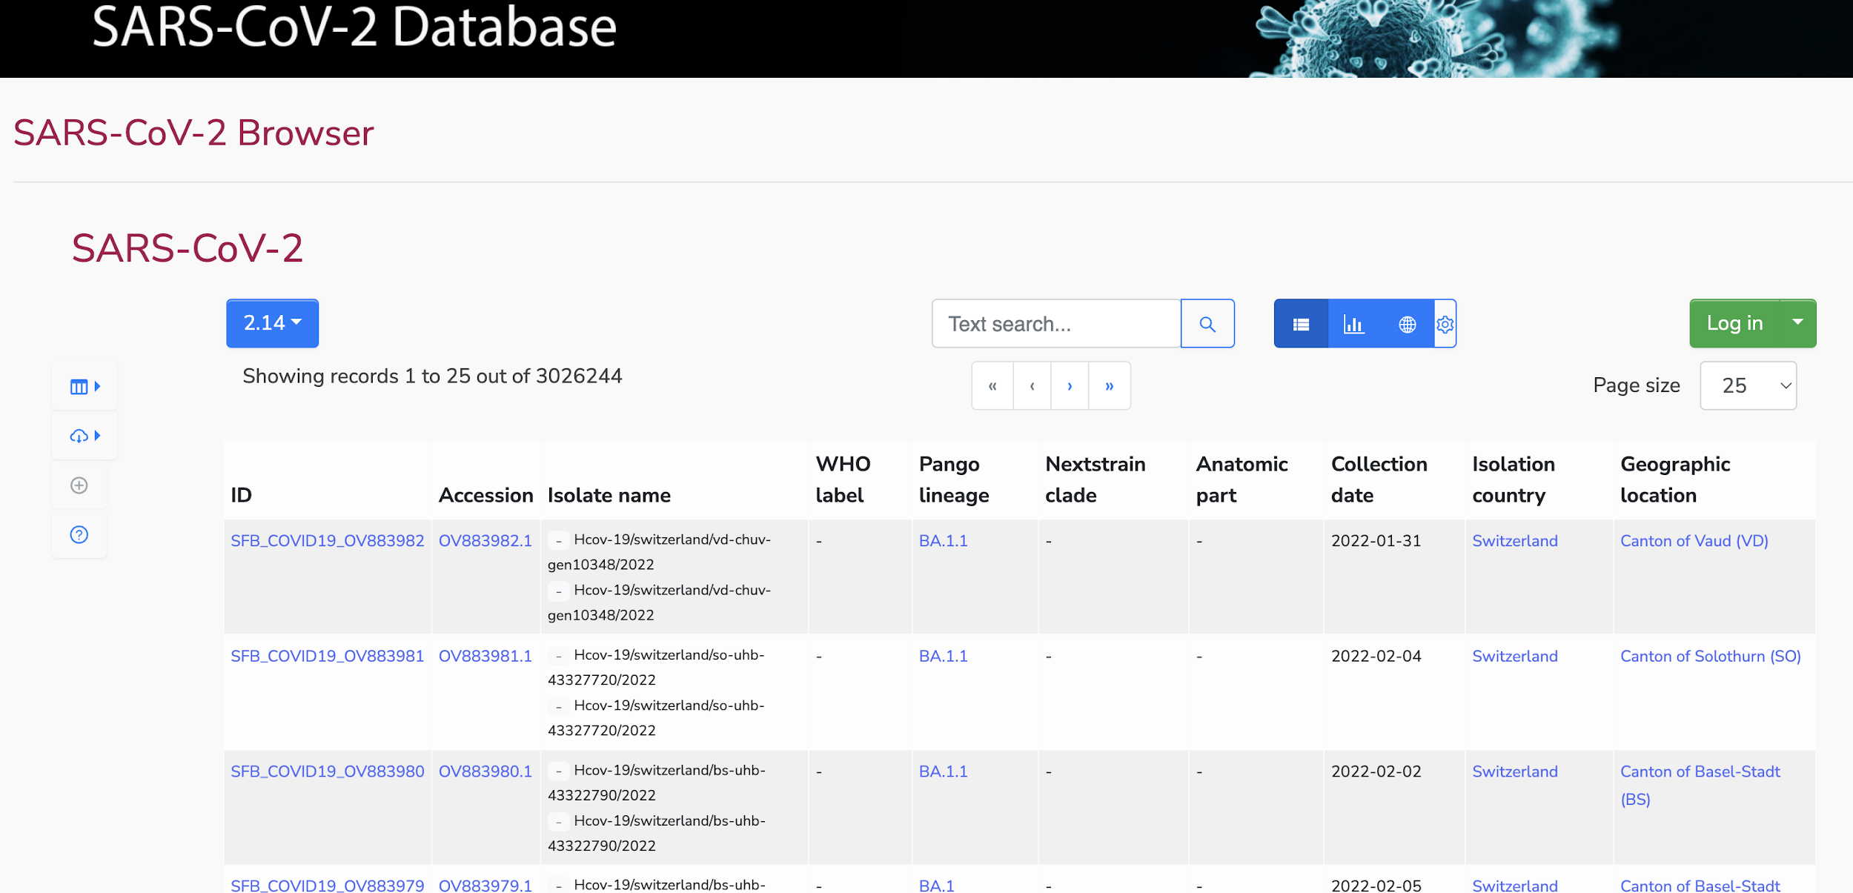
CBF

Slide 24
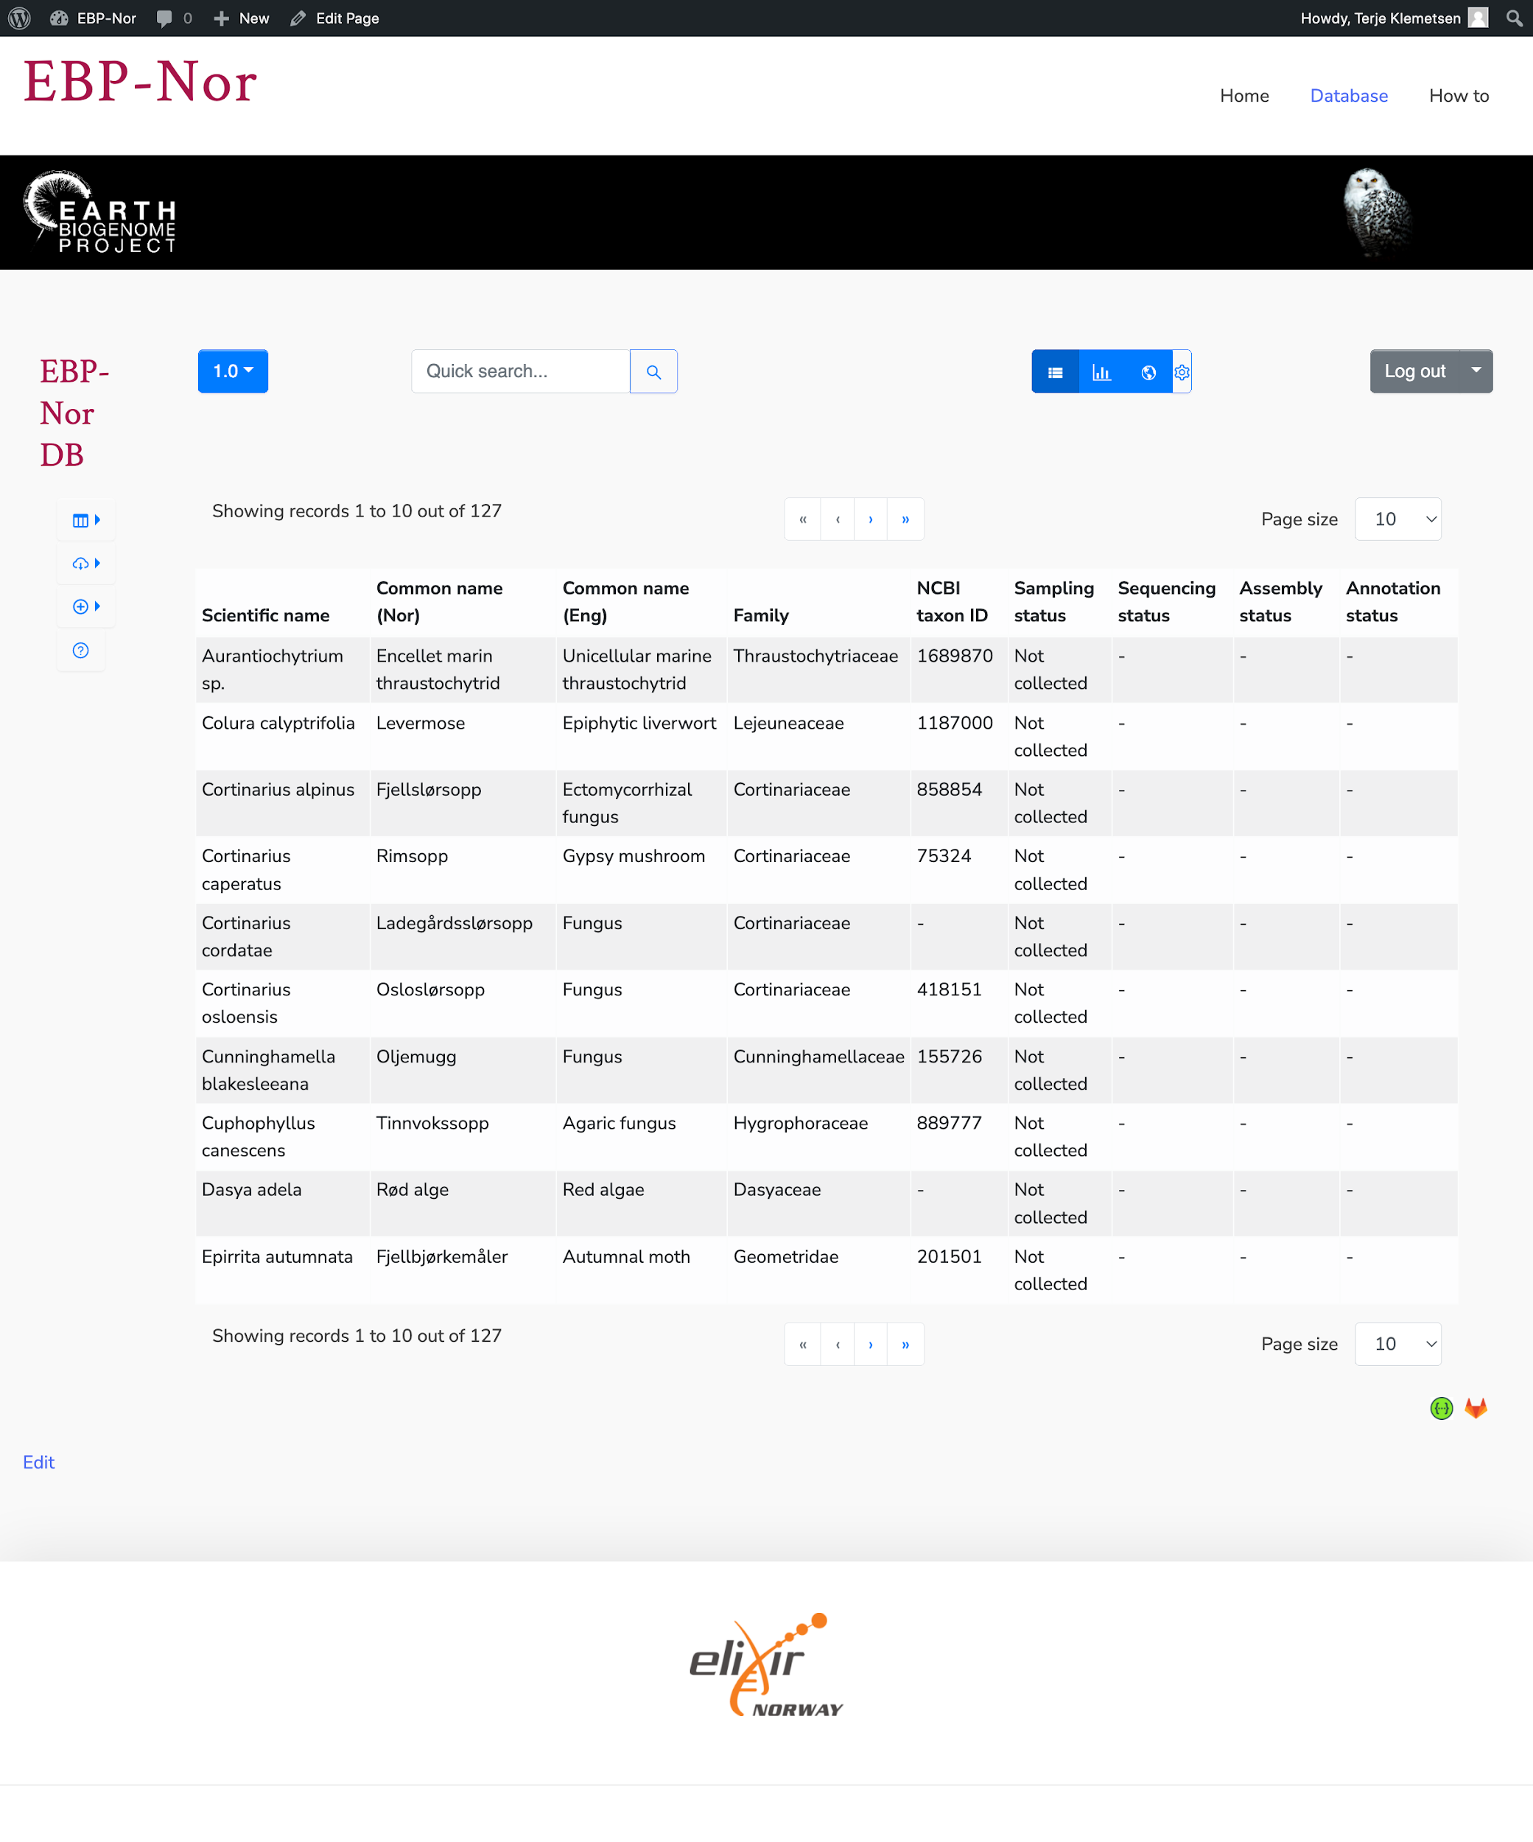
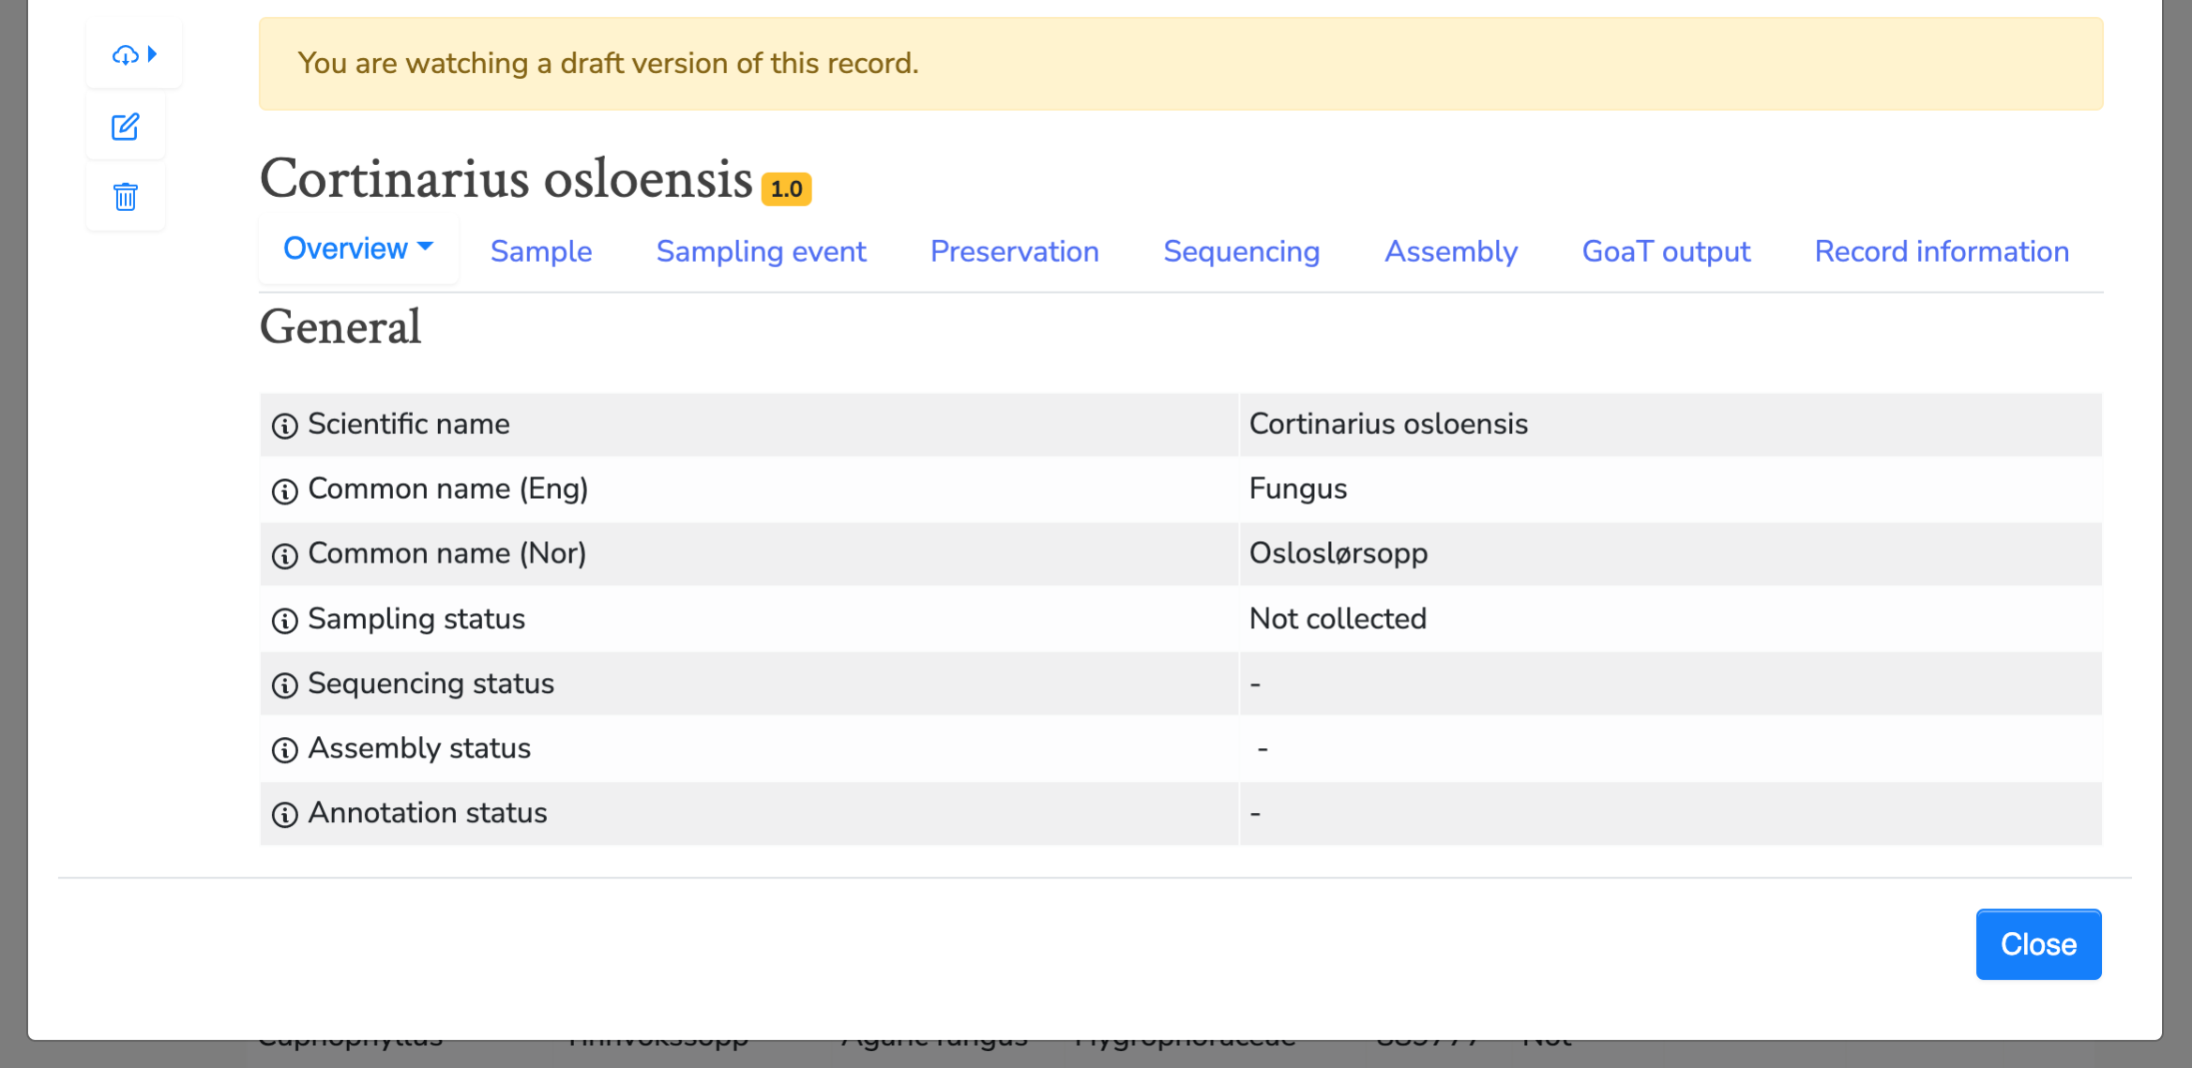
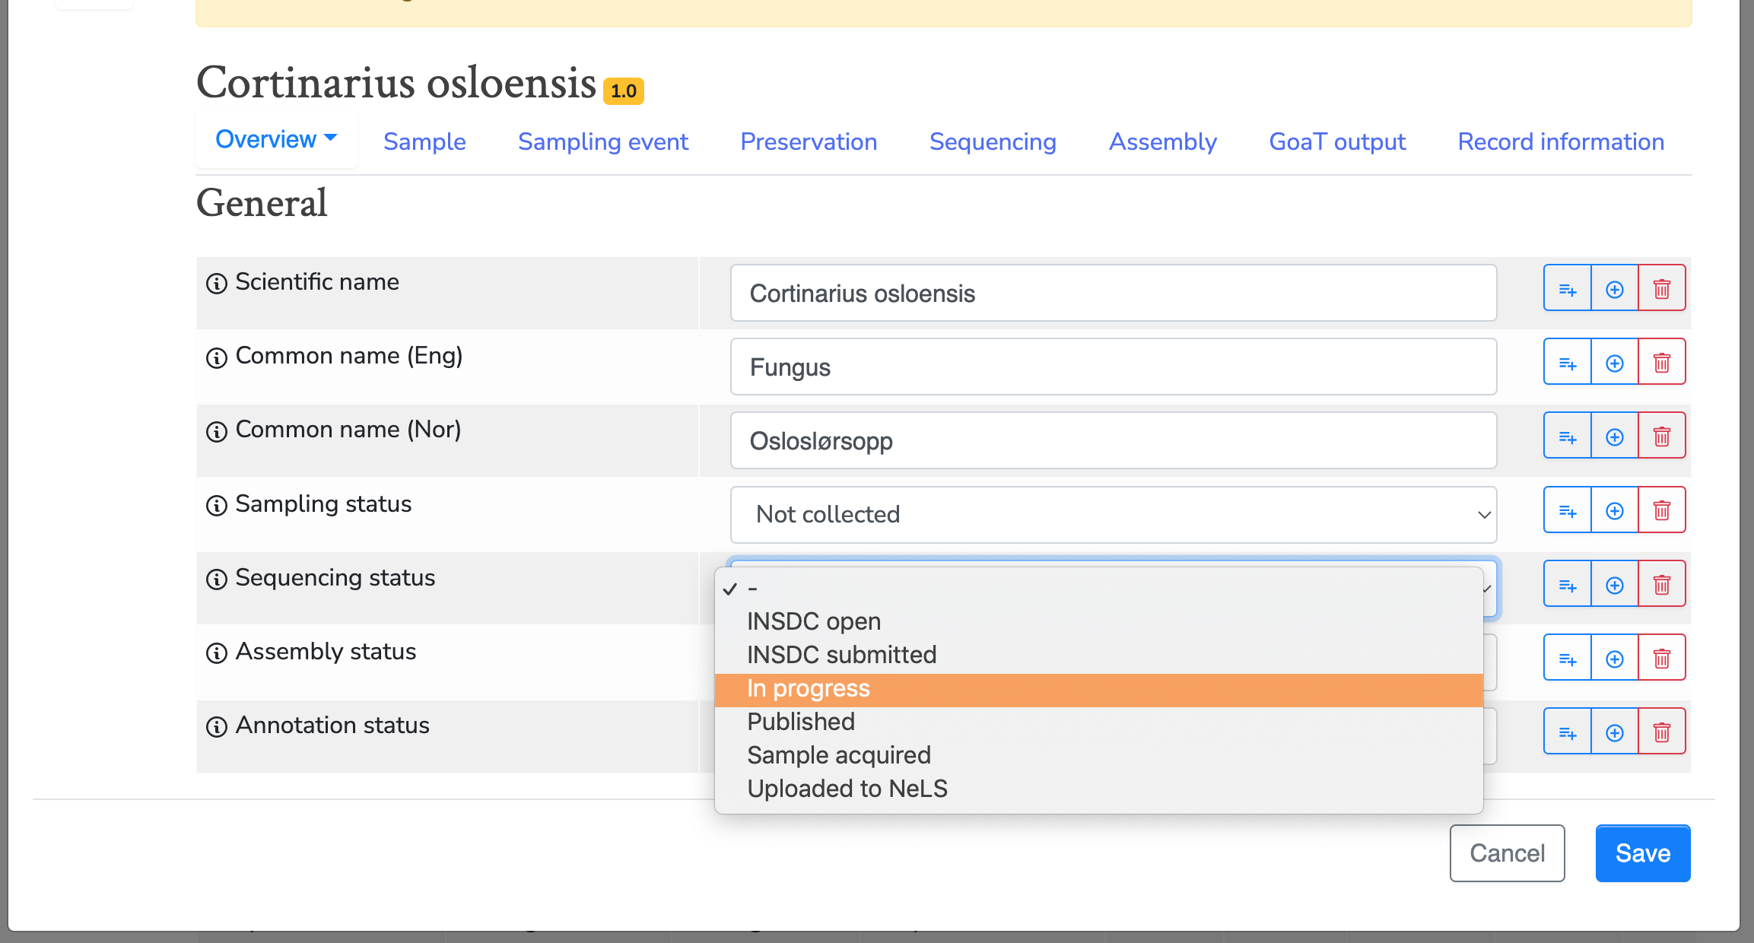
Functionalities - Editing an entry
Slide: Terje Klemetsen

Slide 25
Make it visible
With Rich Metadata
Digital object (DO)
TAG it with a PID

Slide 26
PIDs helps make data FAIR
Medyckyj-Scott, David et al. (2016).

Slide 27
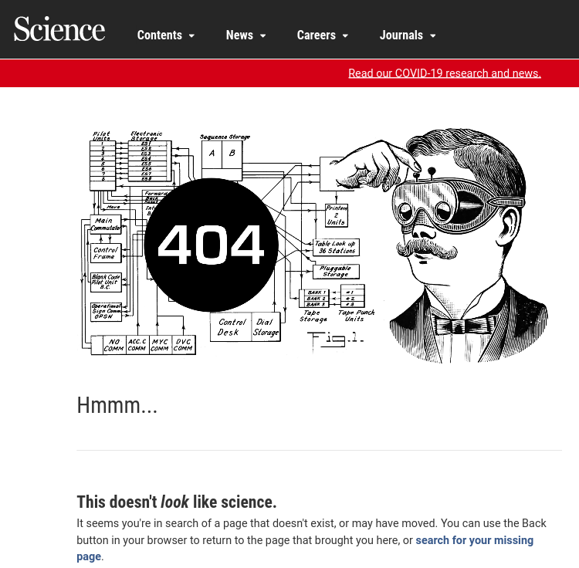
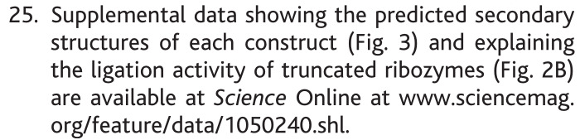
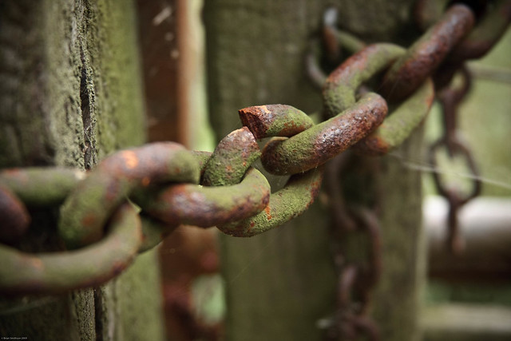
Why don’t I just use a link (URL)?
“Link rot”
farm3.staticflickr.com

Slide 28
PID = PDI = GUID
PID = Persistent Identifier
PDI = Persistent Digital Identifier
GUID = Globally Unique Identifier
Physical objects: a dog, building, microscope, star, person etc
It doesn’t “rot”
A persistent identifier (PID) is a long-lasting reference to a resource
Somebody commits to keep it alive
People AND computers can find it
Digital Objects: data, collections, metadata, software, publications, configurations, categories, workflows etc
globally unique string of characters

Slide 29
A PID consists of two components:
Visible string of letters and/or numbers
1. A unique identifier
2. A service that locates the resource (or “resolves” it)
Behind the scene

Slide 30
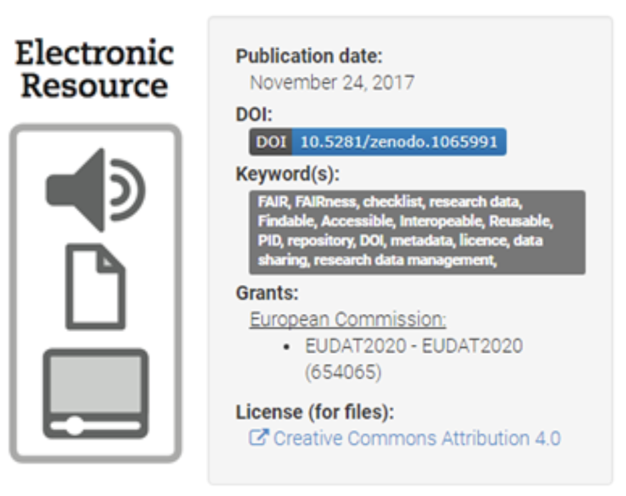
Priciple:
PID Service
TAG
PID
URL
https://www.clarin.eu/sites/default/files/pid-CLARIN-ShortGuide.pdf
Digital object (DO)
01000110 01100001
01110011 01110100
01110001 01100110
01101001 01101100
01100101

Slide 31
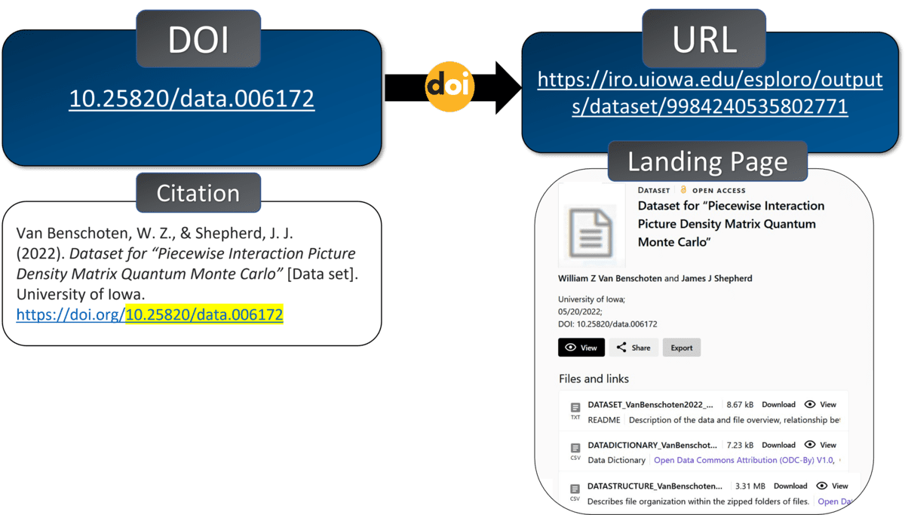
Example
https://blog.lib.uiowa.edu/news/2023/03/07/the-power-of-persistent-identifiers-in-data-sharing/

Slide 32
Persistent over time
.. by design
today
…
...
...
2030
ID is unique and always the same
11839/abc123
11839/abc123
http://www.example.com/
http://www.moved.com/
111000010001111
URL may change over time
111000010001111
Supports access to resource as it moves from one location to another.
Modified from https://b2drop.eudat.eu/s/TCYdyf3eqwE0Ust

Slide 33
Persistent over time
.. by design
today
…
...
2030
Stable
11839/abc123
11839/abc123
http://www.example.com/
http://www.moved.com/
Update information
Redirection
111000010001111
Responsibility of the PID owner to keep it up-to-date when the resource changes
111000010001111
Modified from https://b2drop.eudat.eu/s/TCYdyf3eqwE0Ust

Slide 34


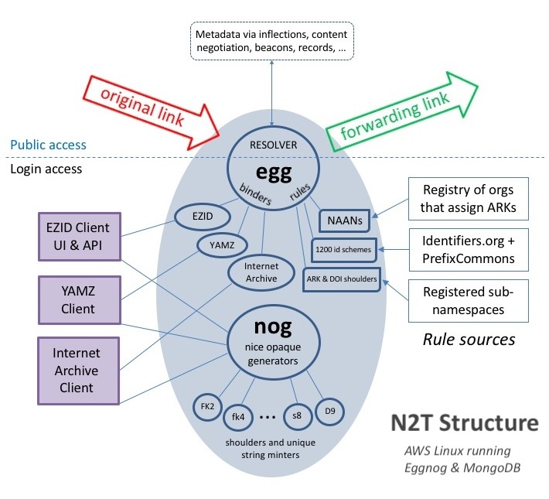
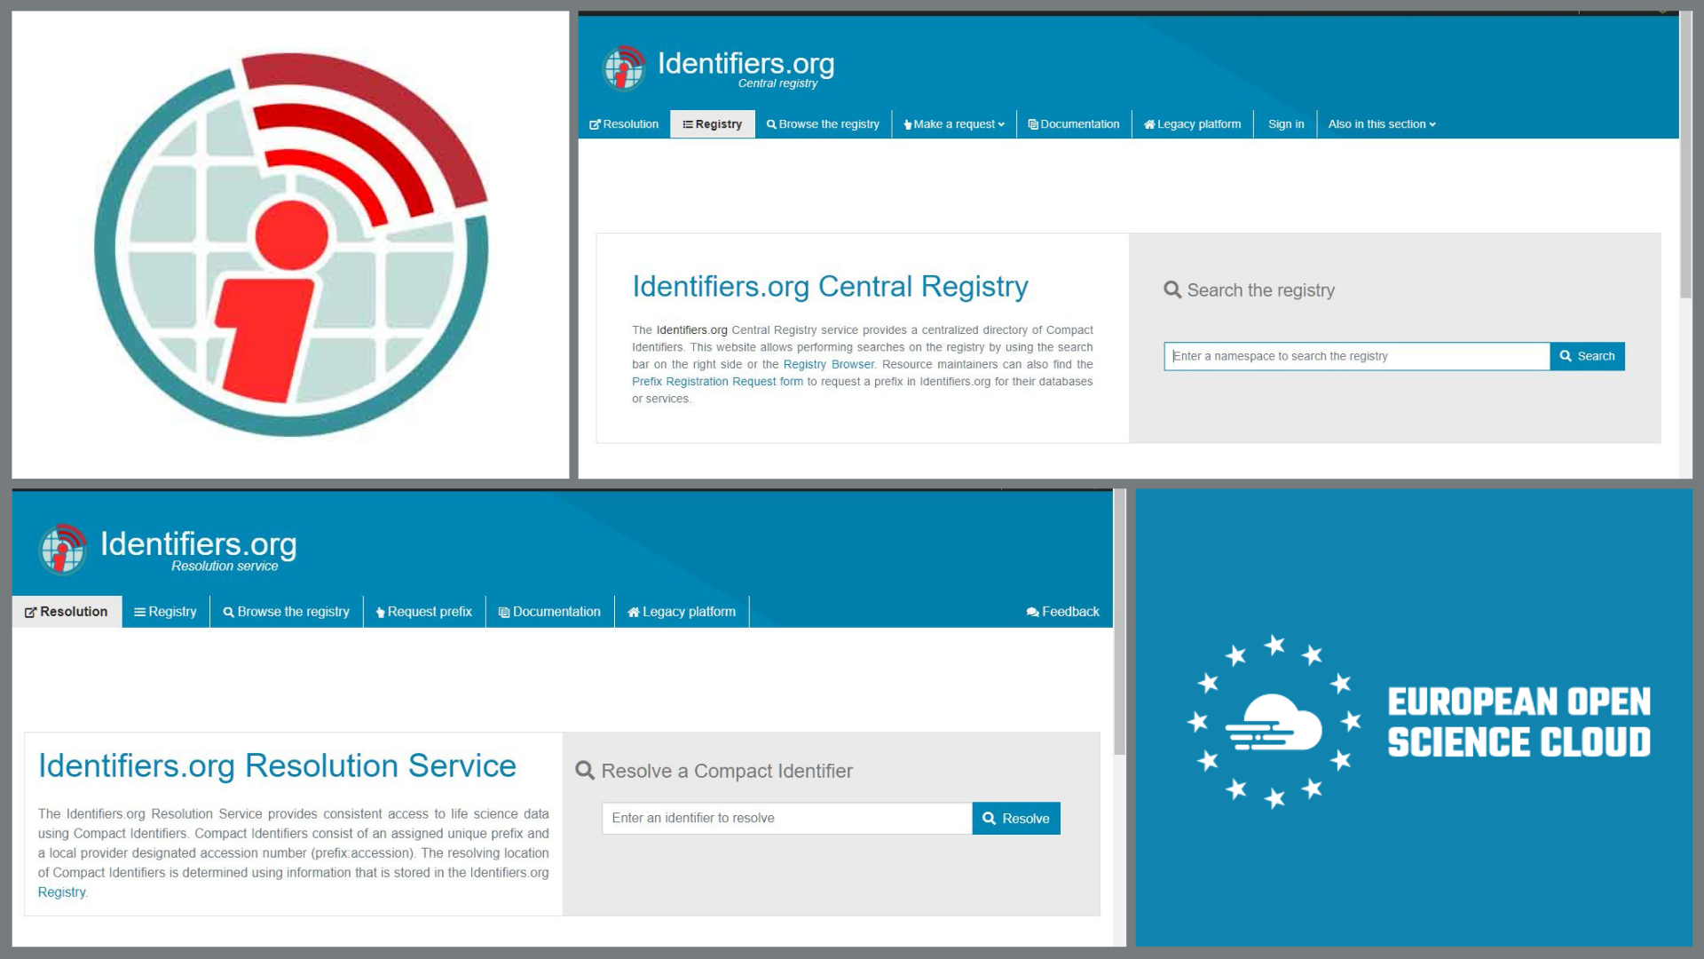
Different systems
Some Common Identifiers:
Digital Object Identifiers (doi:10.1186/2041-1480-3-9)
Handles (hdl:2381/12775)
URN (urn:isbn:0451450523)
Archival Resource Keys (ARK) (ark:/13030/tf5p30086k)
Persistent Uniform Resource Locator (PURL)
Resolver Services
N2T (Name-to-Thing)
Identifiers.org
https://arks.org/about/n2t-global-resolver/
https://eosc-portal.eu/news-and-events/news/identifiers-ensuring-robust-and-reliable-access-life-sciences-data

Slide 35

How do I recognize a PID?
DOI: 10.5281/zenodo.6104400

Slide 36
Anatomy of a DOI
Means that it is actionable: you can paste in a web browser address bar and be taken to the identified source.
globally unique together
https://doi.org/ 10.5281 / zenodo.6104400
Resolver service
Directory
indicator
Suffix
Local ID = an “Accession”
Only guaranteed to be locally unique within the database or source
Prefix
Assigned by
DOI Foundation
Assigned by RA members (registrants)
e.g. Zenodo
Assigned by
DOI Registration Agencies (RAs)
e.g. Crossref, DataCite, etc

Slide 37










PIDs for...
Grant IDs
People
Grants and Projects
Data and Software
Instrument IDs
Funder IDs
Funding bodies
Instruments
Organizations and Institutions
Methods, protocols and reagents
Publications
Physical samples

Slide 38
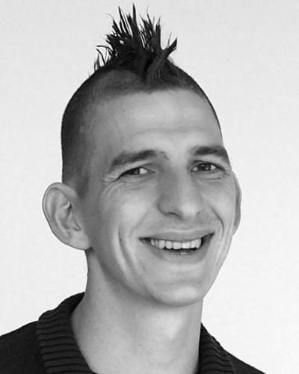

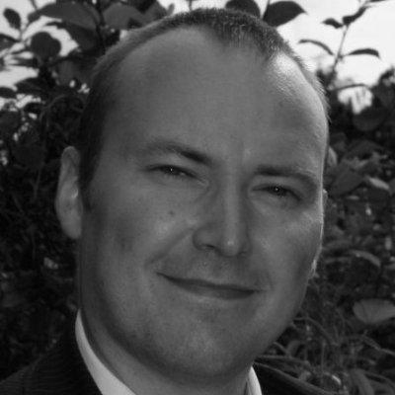
PIDs connect different entities in research
Creates
Dataset #1
DOI
Creates
Writes
Uses
Writes
Cell Line #1
RRID
Writes
Cell Line #2
RRID
Article #1 DOI
Creates
Article #2 DOI
Dataset #2
DOI
Creates
Dataset #3
DOI
Creates
Writes

Slide 39

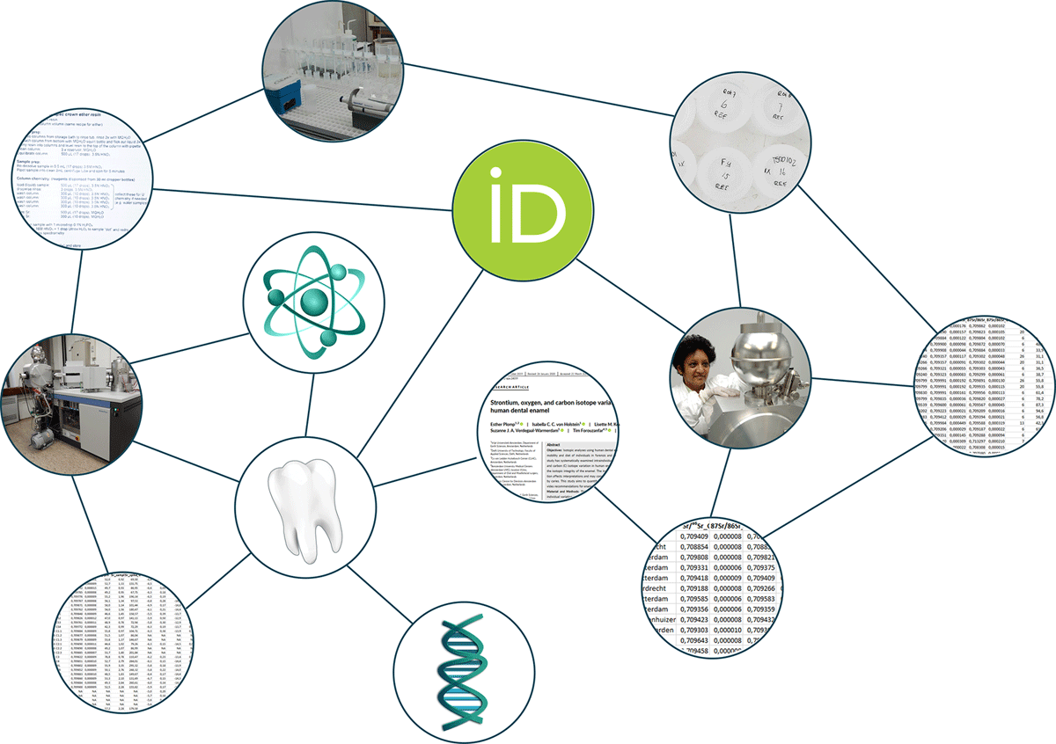
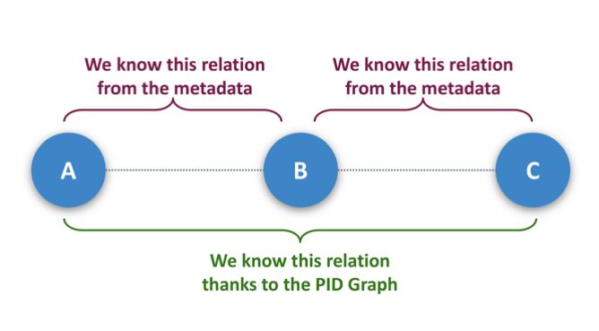

PID graphs
“I want to see all datasets funded by RCN cited by this article”
Publication
Datasets
Publication
Datasets
Publication
Funder/Grant
Datasets
Publication
Publication

Slide 40

Except where otherwise noted, this work is licensed under:
https://creativecommons.org/licenses/by/4.0/

